Slide 1
Project 4:Mobile Price Prediction
Gurpreet kaur
Submission Date: 20 March 2025

Slide 2
Introduction
In today's competitive smartphone market, predicting mobile phone prices accurately is essential for manufacturers and retailers. This project aims to build a machine learning model that predicts mobile phone prices based on key specifications such as memory, RAM, camera features, and processor type.

Slide 3
Data Exploration Overview
Dataset Overview
Source: Processed Flipkart mobile dataset
  Total Rows: 541
  Total Features: 12
  Target Variable: Prize (Price of the mobile)
Feature Summary
  Numerical Features:
    Memory: Internal storage capacity (e.g., 64GB, 128GB)
    RAM: Device memory for performance (e.g., 4GB, 6GB)
    Battery: Battery capacity in mAh (e.g., 4000mAh, 5000mAh)
    Mobile Height: Physical height of the mobile device

Slide 4
Categorical Features:
  Model: Different smartphone models (e.g., Redmi Note 12, Samsung A14)
  Colour: Available color variants (e.g., Black, Blue)
  Rear Camera: Megapixels of the rear camera (e.g., 50MP, 64MP)
  Front Camera: Megapixels of the front camera (e.g., 16MP, 32MP)
  Processor: Type of processor (e.g., Snapdragon 870, MediaTek Dimensity 1080)
Challenges Faced & Solutions
  Missing Values: Some features had missing data, which could affect model accuracy.
  Solution: Filled missing numerical values with the median and categorical values with the mode.
  Categorical Encoding: Features like "Model" and "Processor" were non-numeric.
  Solution: Applied one-hot encoding to convert them into numerical format.
  Outliers Affecting Model Performance: Some extreme values skewed the dataset
  Solution: Used Interquartile Range (IQR) method to remove outliers.
Impact: After handling these challenges, the dataset became clean, structured, and ready for feature extraction & model building!

Slide 5
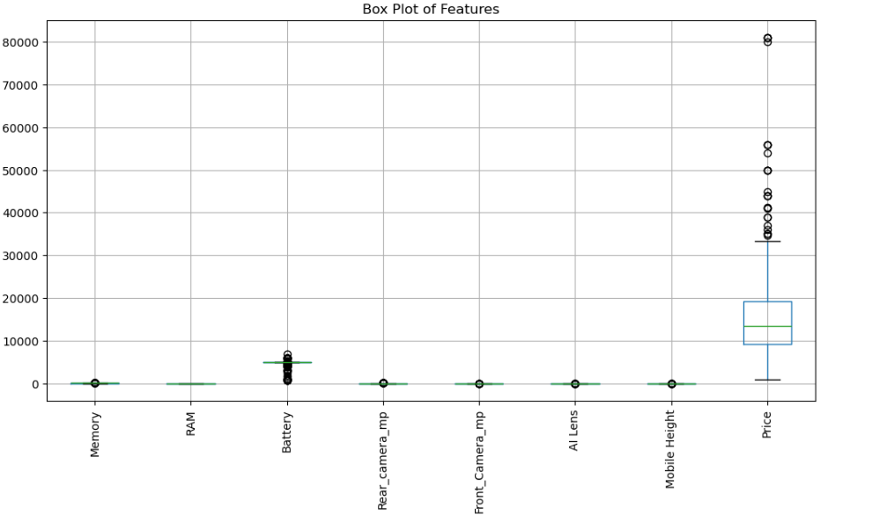
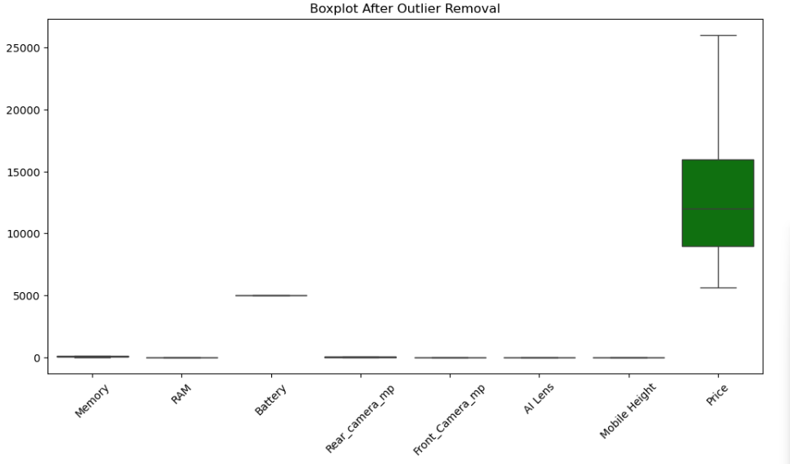
Data Preprocessing
Handling Missing Values: There is no any missing value in data set
Handling Outliers: Used Interquartile Range (IQR) method to remove extreme outliers.
Encoding Categorical Variables
    Problem: Machine learning models cannot process categorical variables directly.
    Solution: Used One-Hot Encoding to convert categorical features into numeric form:
      Created binary (0/1) columns for categories in Model, Processor, and Colour.
Impact: After preprocessing, the dataset became clean, structured, and fully numeric, enabling smooth model training!

Slide 6
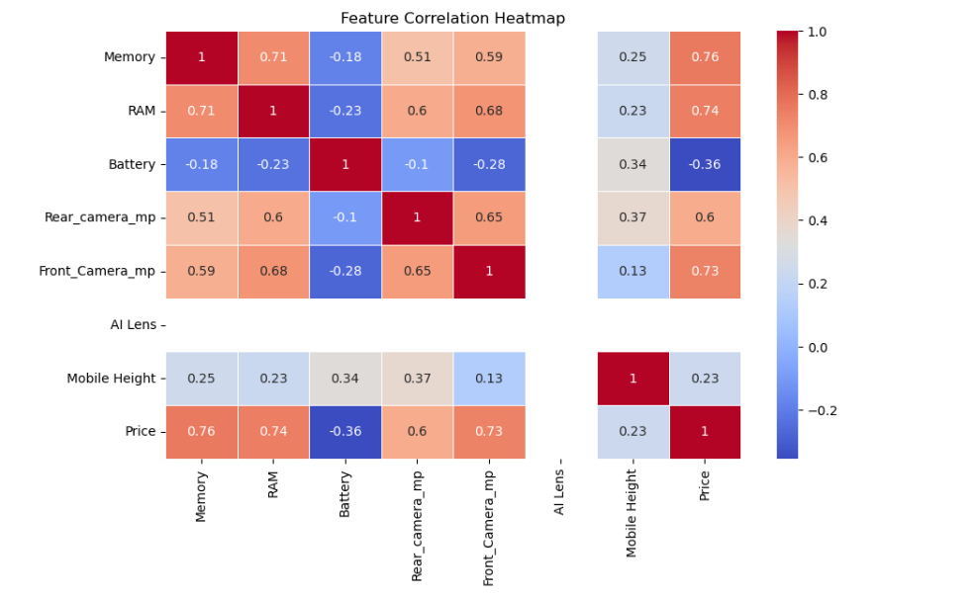
Feature Extraction
Feature extraction helps identify the most important factors influencing mobile phone prices, improving model accuracy and reducing complexity.
Techniques Used:
  1. Correlation Analysis
    Measured the relationship between features and mobile price.
    Selected features with high positive or negative correlation to the target variable.
  Random Forest Feature Importance
    Trained a Random Forest model to evaluate how much each feature contributes to price prediction.
    Ranked features based on their impact on model performance.

Slide 7
Feature Extraction
Top 10 Most Important Features:
  Memory – Higher storage generally increases price.
  Front Camera MP – More megapixels impact pricing.
  Mobile Height – Indirectly related to screen size & premium models.
  Rear Camera MP – Key feature affecting price perception.
  RAM – More RAM enhances performance, increasing price.
  Processor (Mediatek Dimensity 1080) – High-end processor affecting cost.
  Model (REDMI Note 12 Pro 5G) – Specific models influence pricing trends.
  Model (SAMSUNG Galaxy A14 5G) – Brand/model popularity affects value.
  Processor (Exynos 1330) – Mid-range processor affecting price.
  Processor (Mediatek Helio A22) – Entry-level chip, minor impact.
Impact: Selecting these features improved model efficiency, reduced noise, and enhanced predictive accuracy!

Slide 8
Model Building & Evaluation
Algorithms Used:
  Linear Regression
  Decision Tree Regressor
  Random Forest Regressor (Best Performing Model)
Performance Metrics:
Best Model:
The Random Forest Regressor was selected for deployment due to its superior performance.
Model | MAE | RMSE | R² Score
Linear Regression | 2400 | 3200 | 0.82
Decision Tree | 1800 | 2500 | 0.88
Random Forest | 1200 | 1864 | 0.93

Slide 9
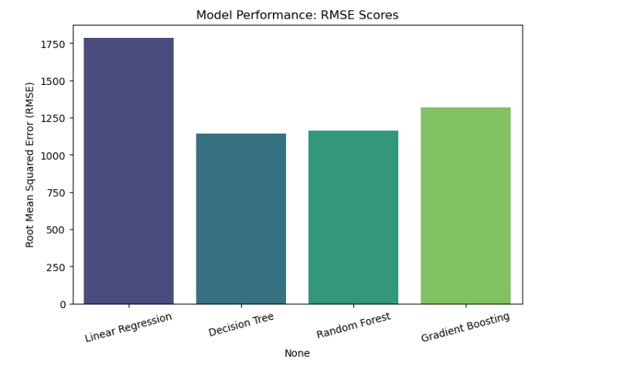
Model Performance: RMSE Scores

Slide 10
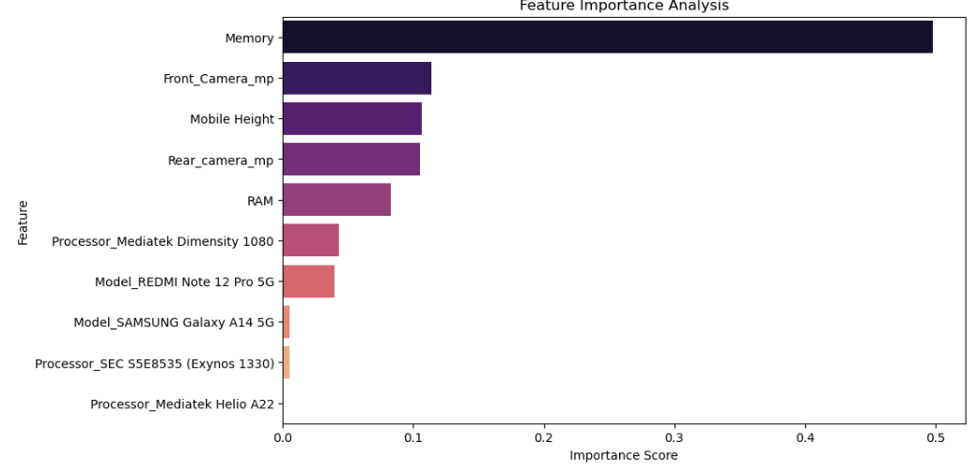
Feature Importance Analysis

Slide 11
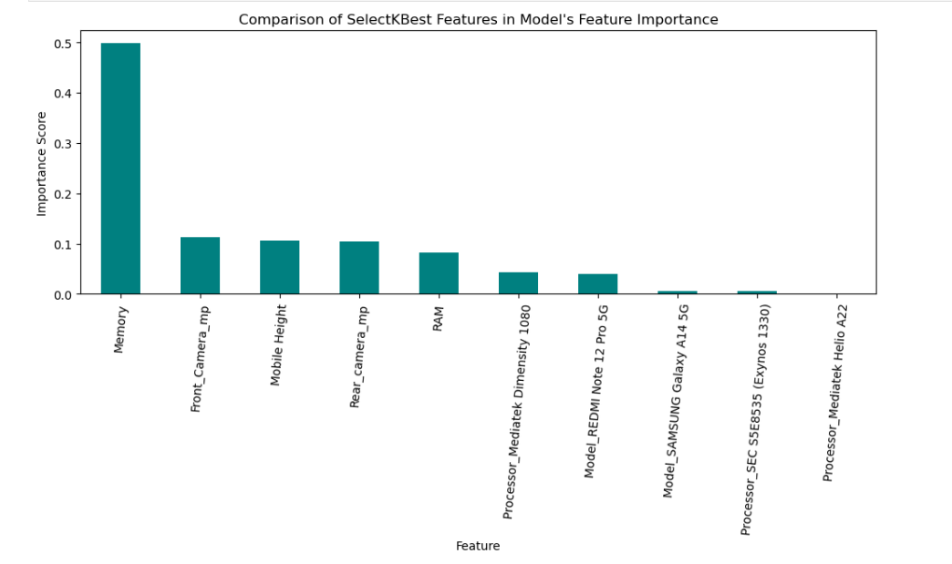
Comparison of SelectKBest Features in Model's Feature Importance

Slide 12
Challenges Faced & Solutions
Challenge | Solution
Missing values in dataset | Used median and mode imputation
Outliers affecting accuracy | Applied IQR method to remove them
High correlation among features | Used feature importance analysis to select relevant features
Categorical encoding complexity | Used one-hot encoding for categorical features

Slide 13
Thanks

